Slide 1
Chapter 4
Functions

Slide 2

Figure 4-1

Slide 3
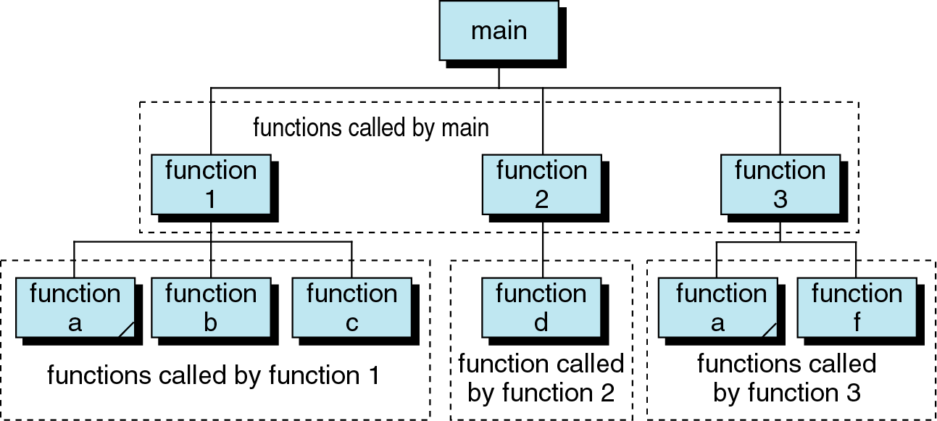
Figure 4-2

Slide 4
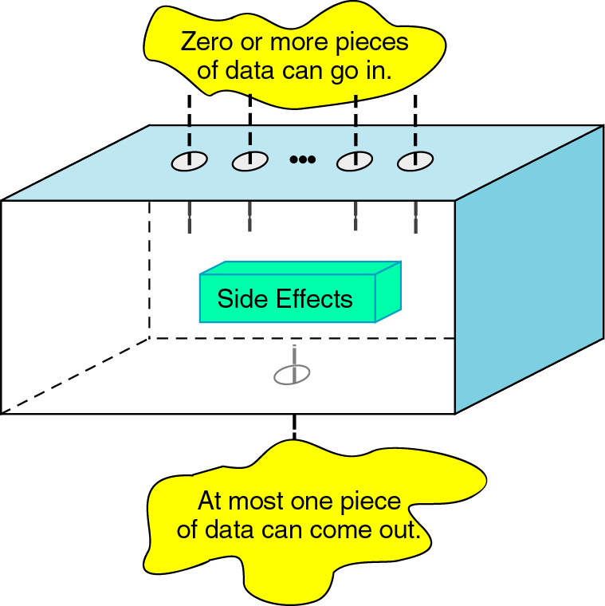
Figure 4-3

Slide 5
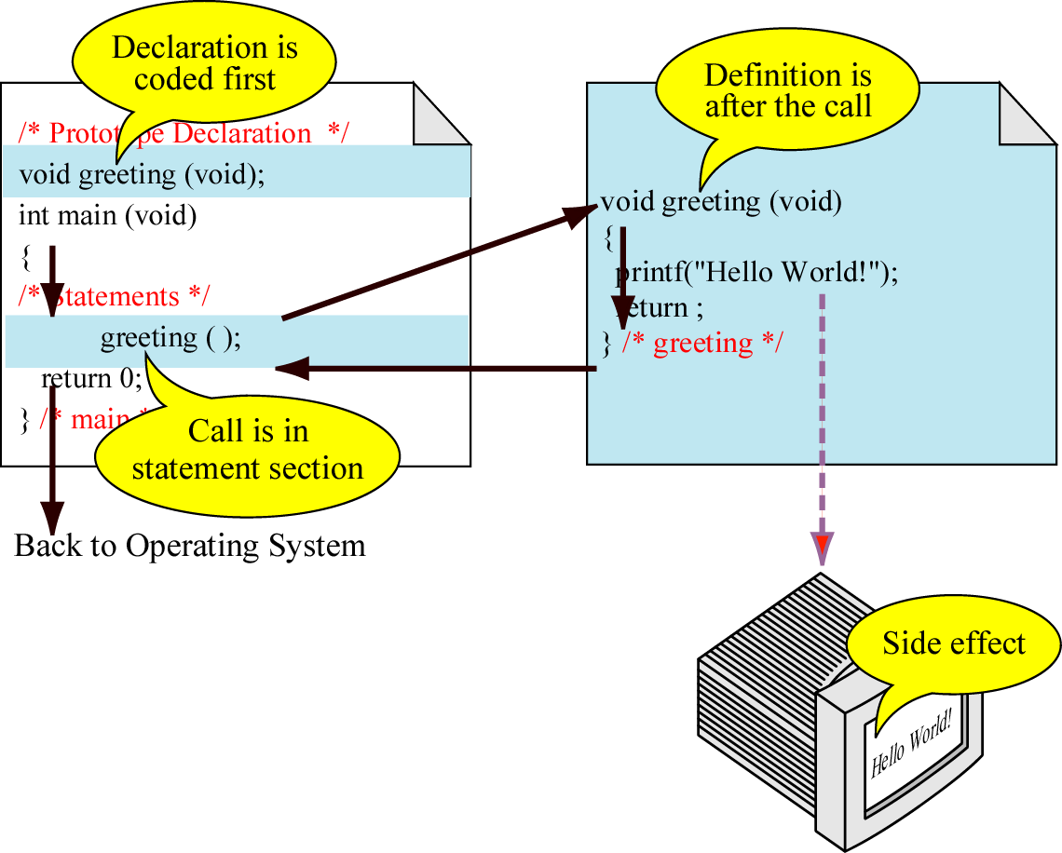
Figure 4-4

Slide 6
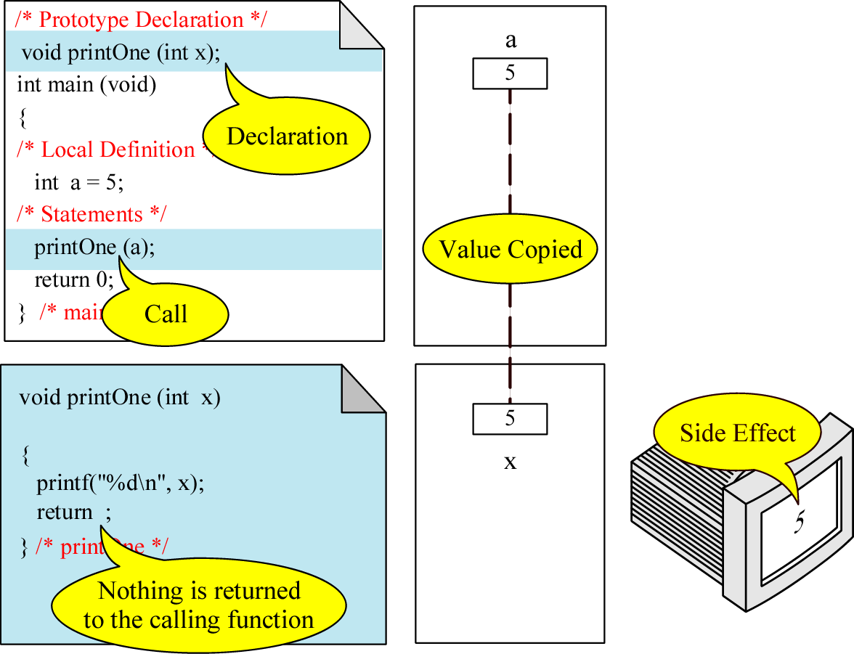
Figure 4-5

Slide 7
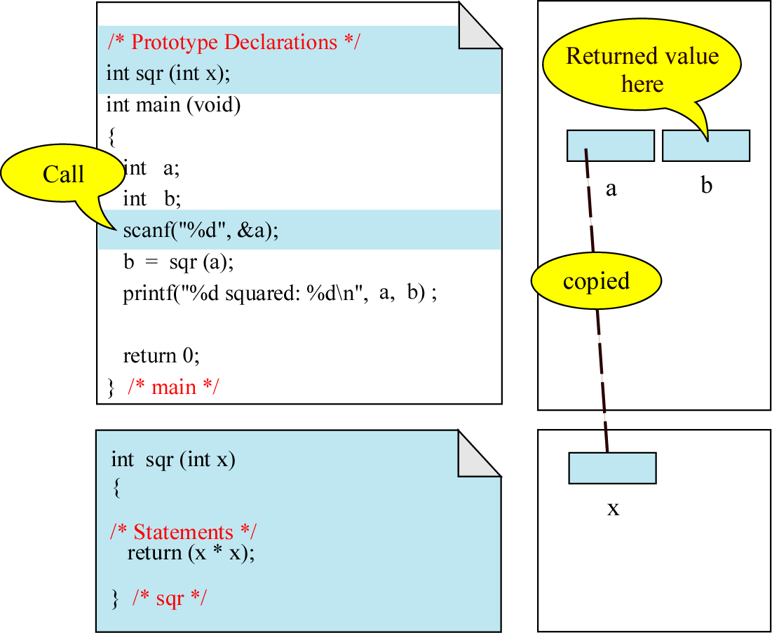
Figure 4-6

Slide 8
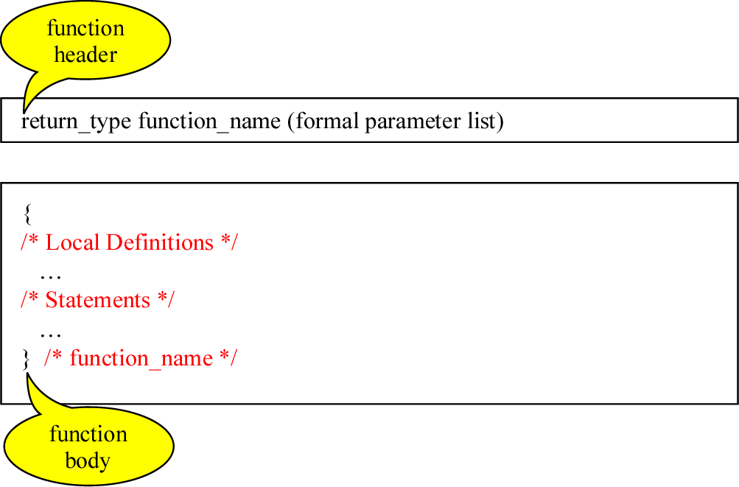
Figure 4-7

Slide 9
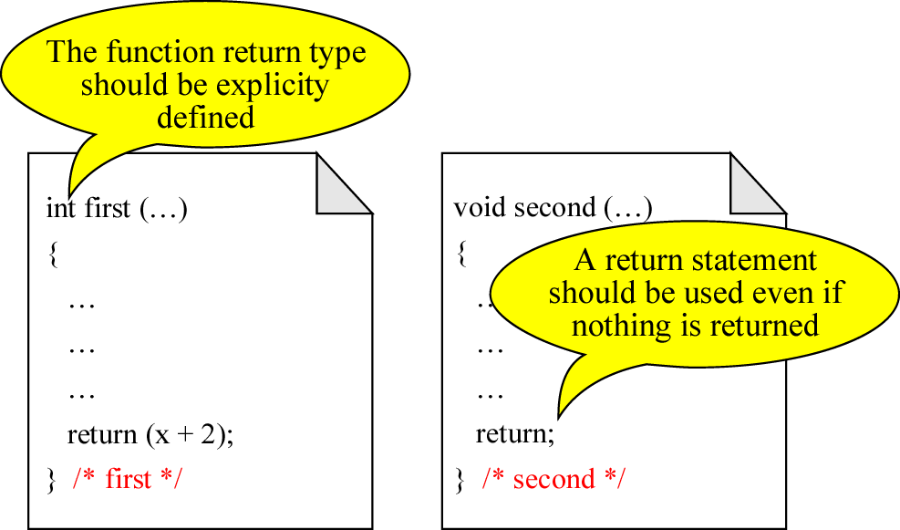
Figure 4-8

Slide 10
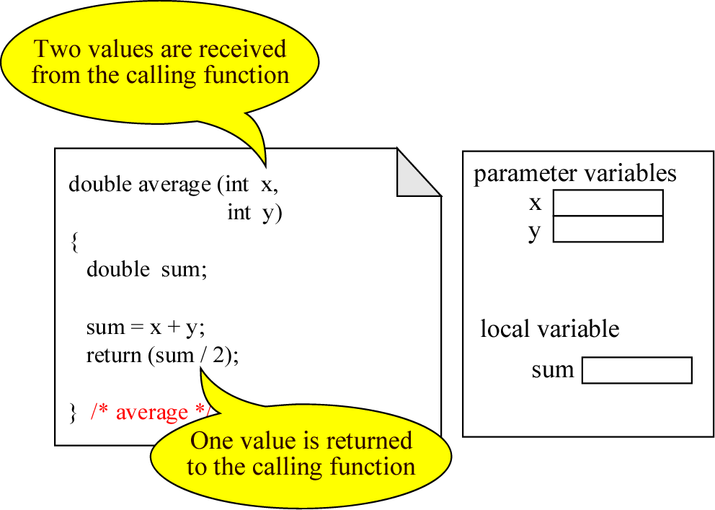
Figure 4-9

Slide 11
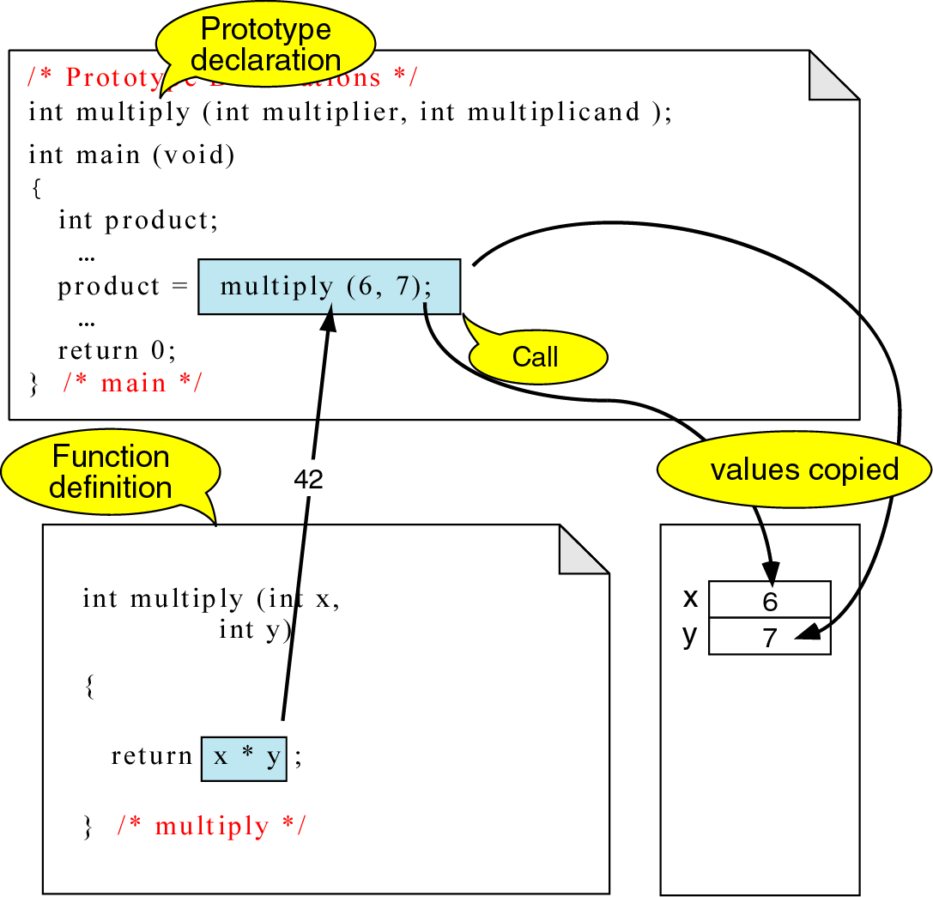
Figure 4-10

Slide 12
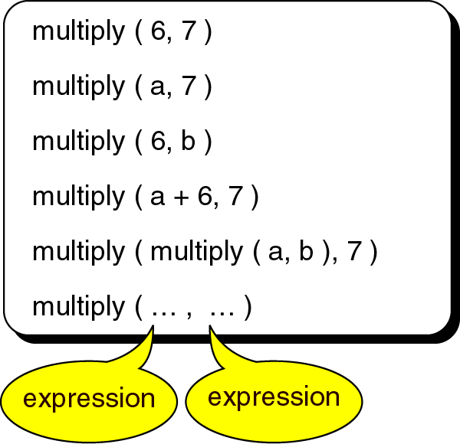
Figure 4-11

Slide 13
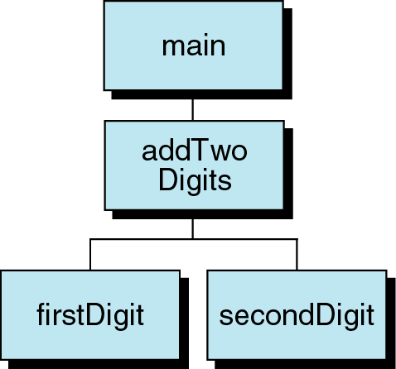
Figure 4-12

Slide 14
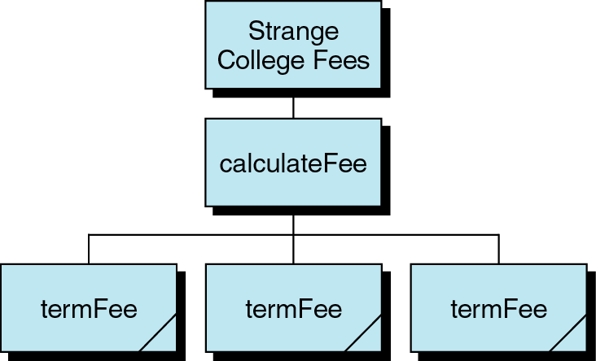
Figure 4-13

Slide 15
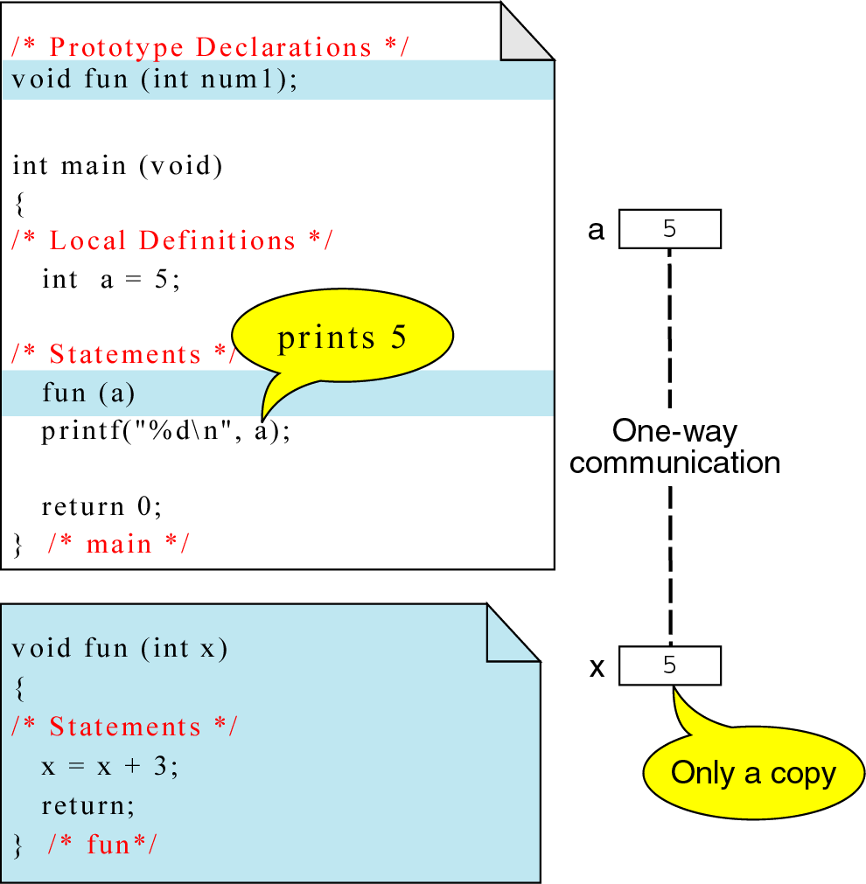
Figure 4-14

Slide 16
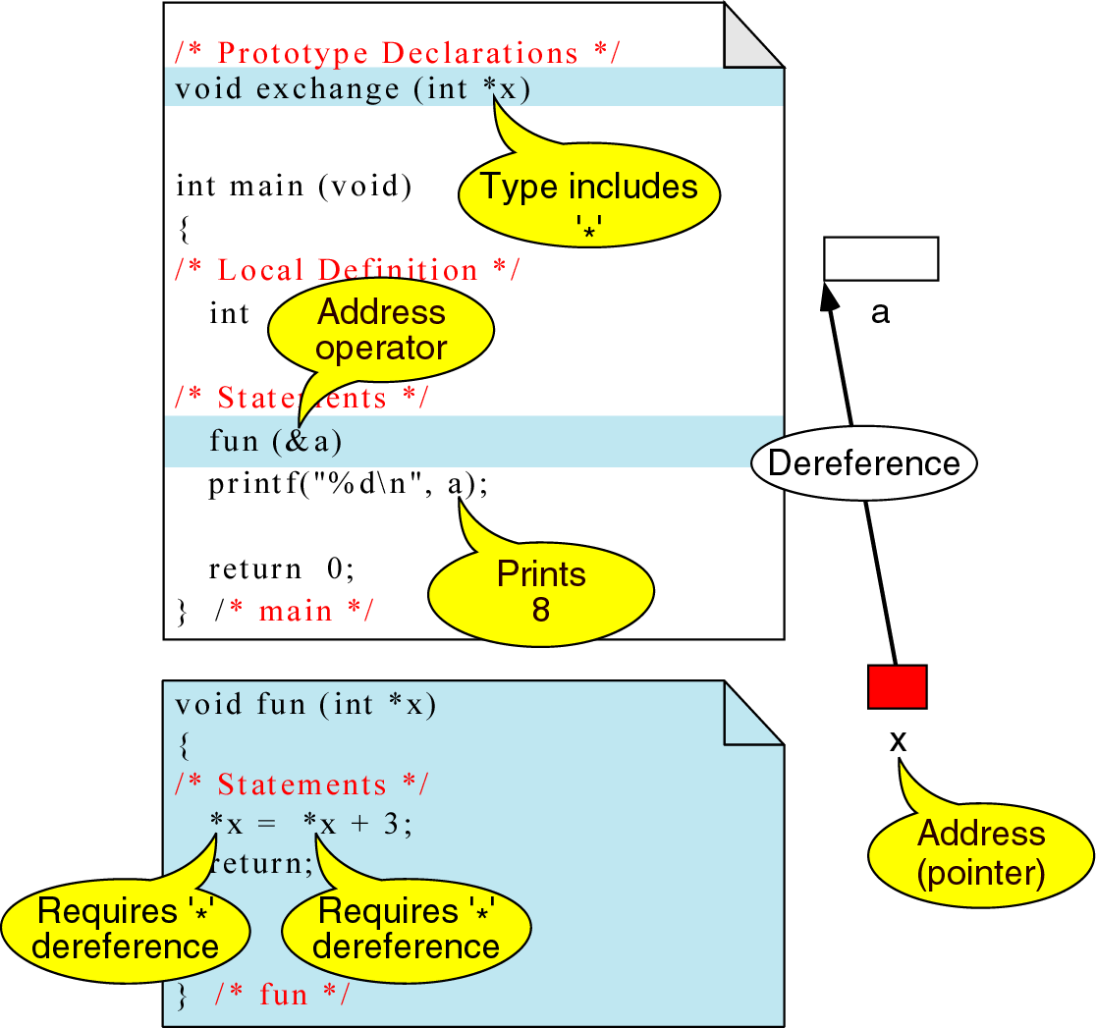
Figure 4-15

Slide 17
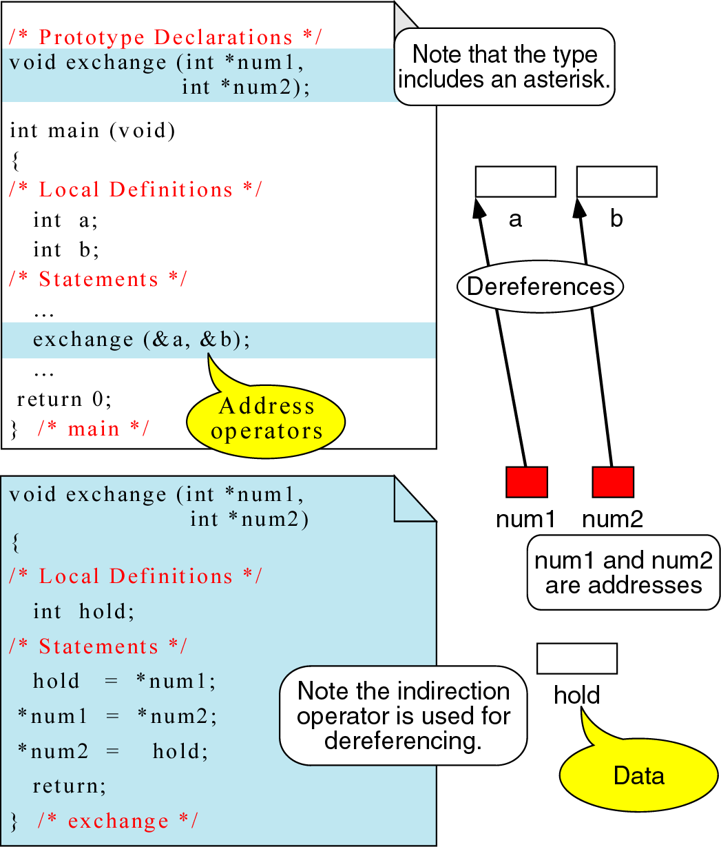
Figure 4-16

Slide 18
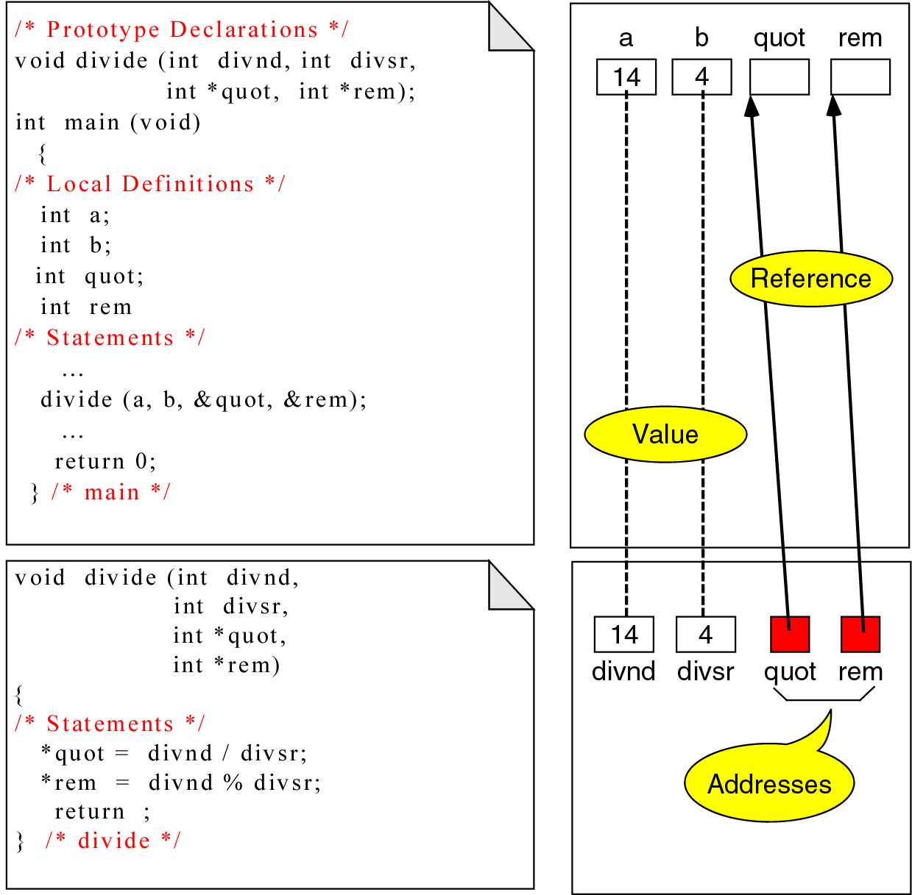
Figure 4-17

Slide 19
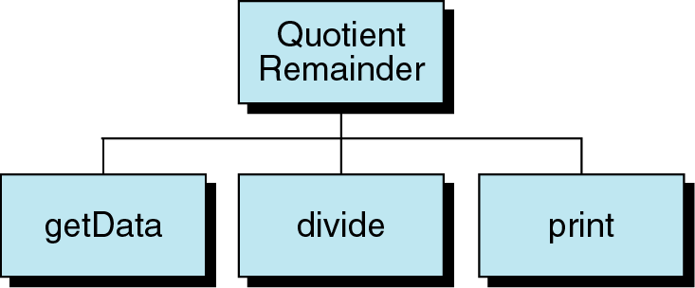
Figure 4-18

Slide 20
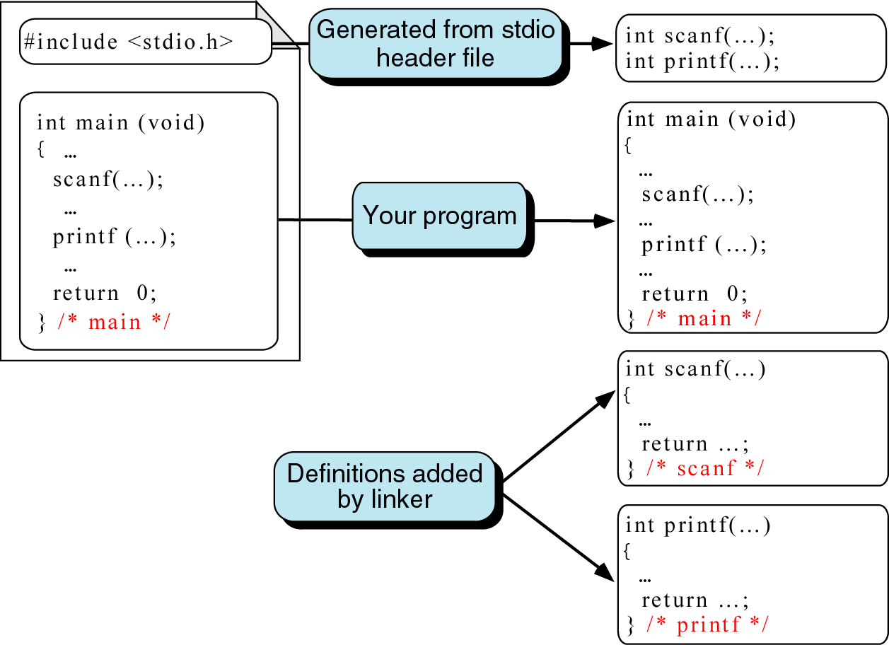
Figure 4-19

Slide 21
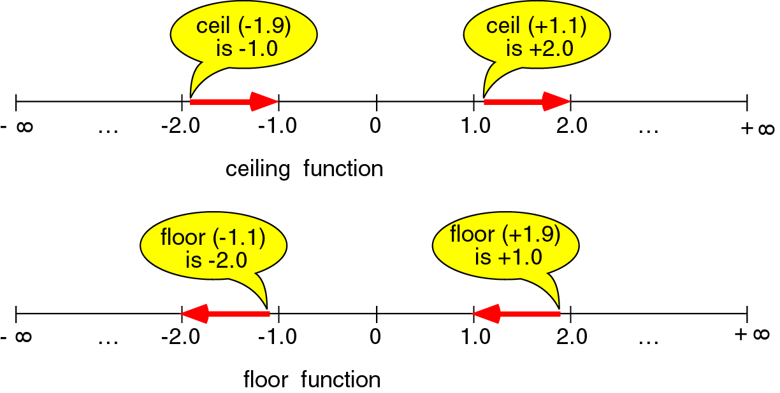
Figure 4-20

Slide 22
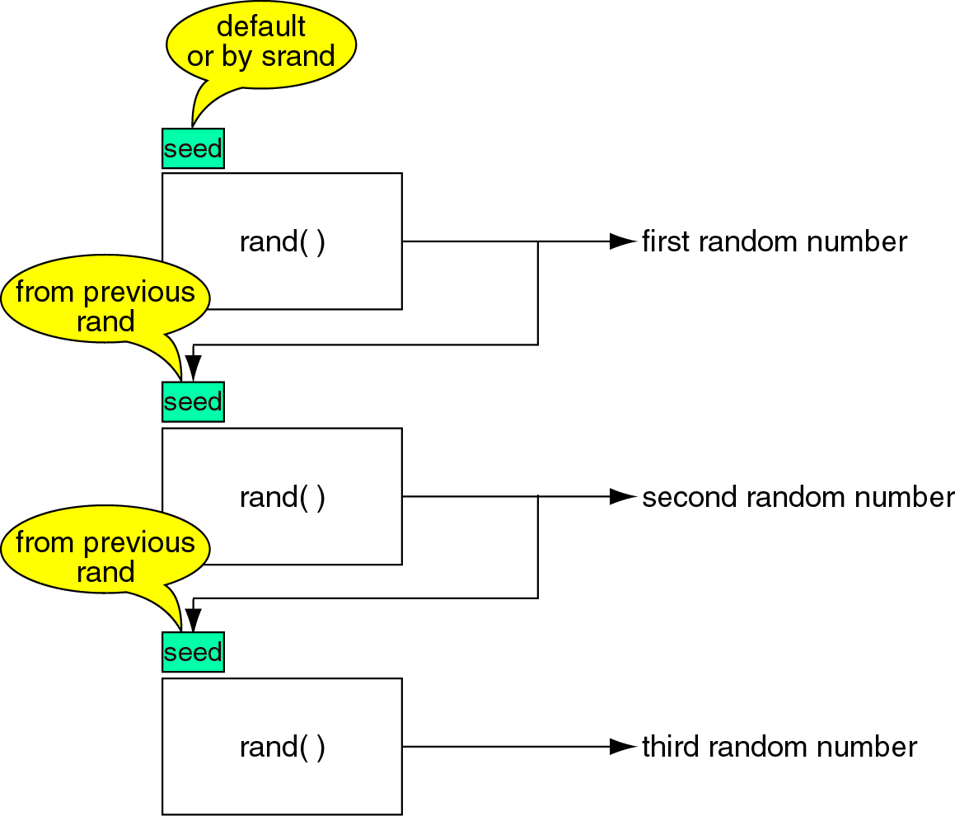
Figure 4-21

Slide 23
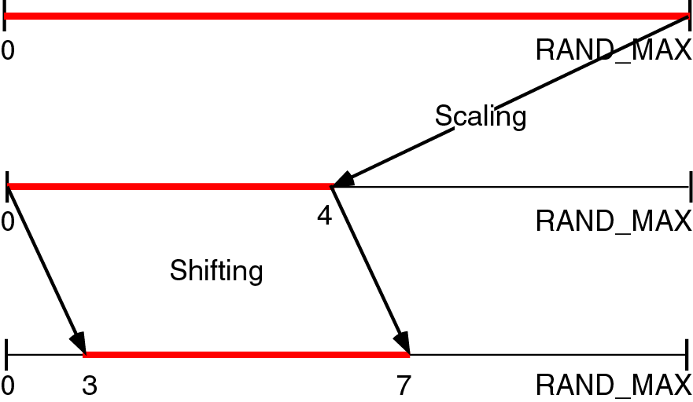
Figure 4-22

Slide 24
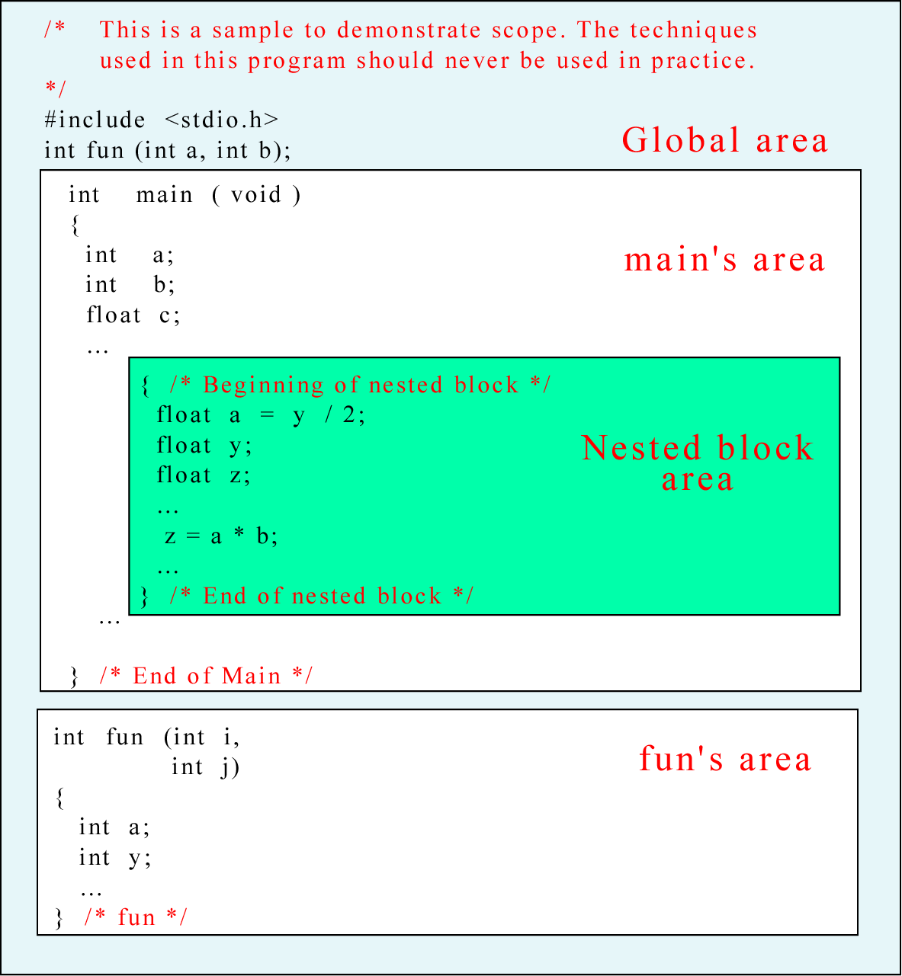
Figure 4-23

Slide 25
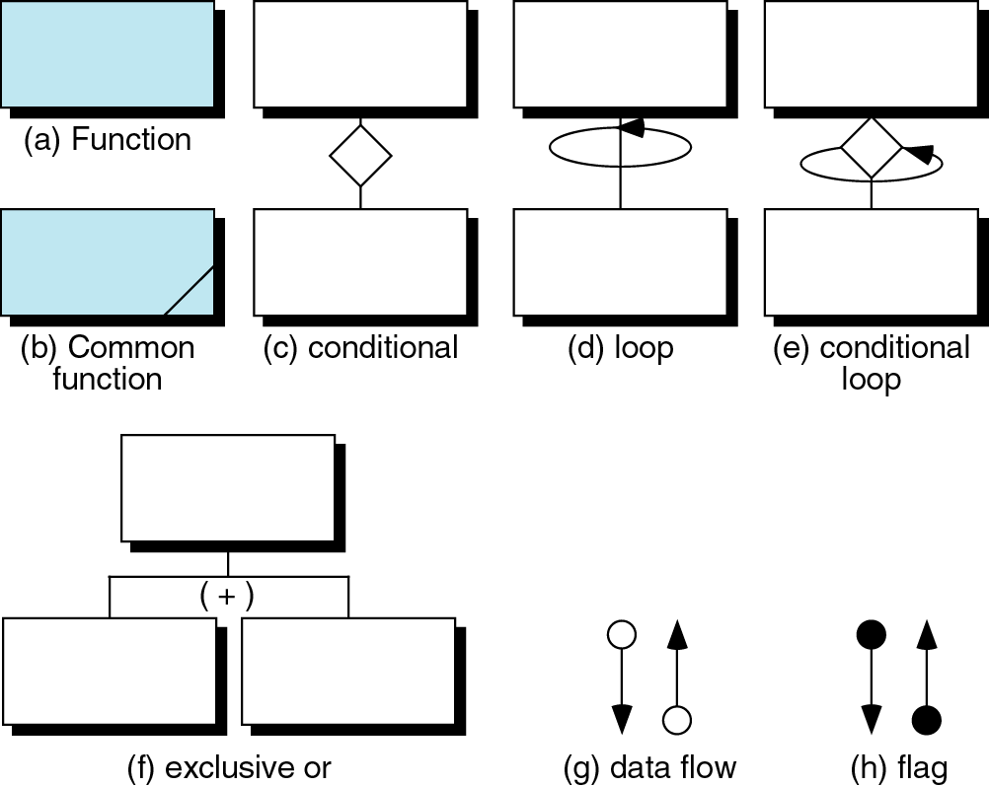
Figure 4-24

Slide 26
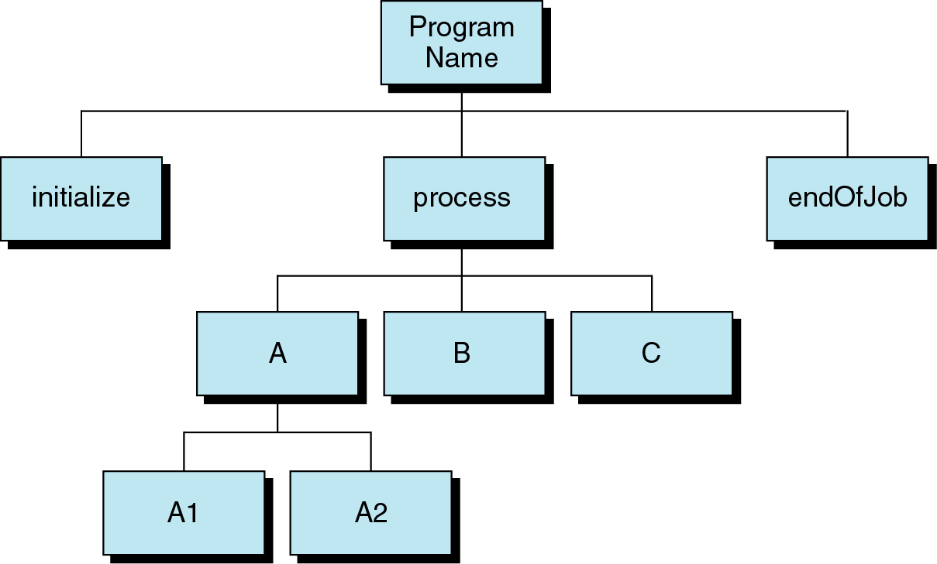
Figure 4-25

Slide 27
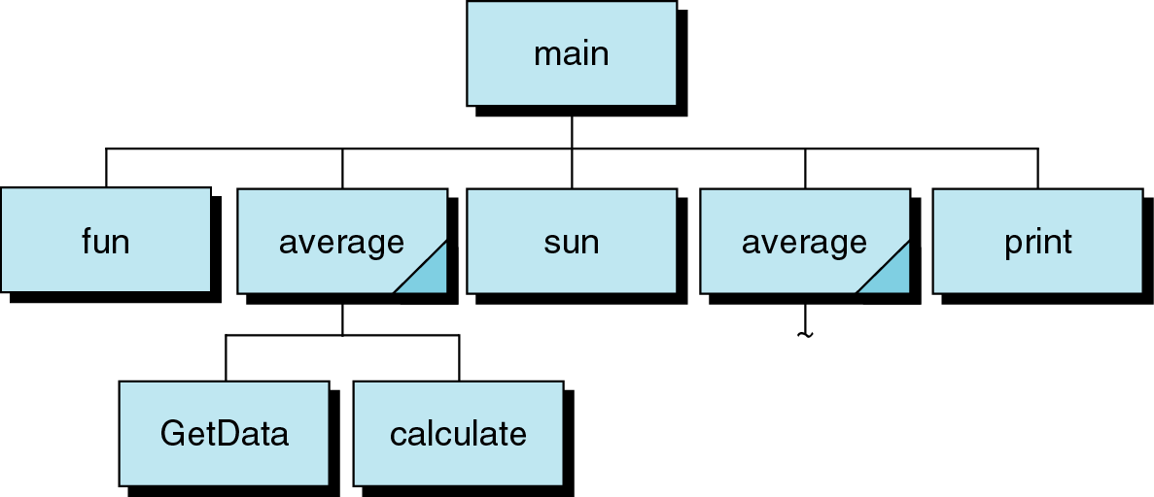
Figure 4-26

Slide 28

Figure 4-27

Slide 29
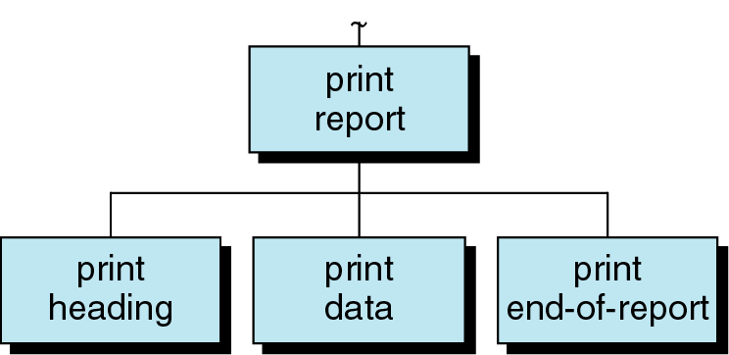
Figure 4-28

Slide 30
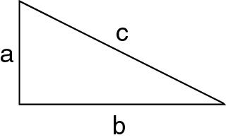
Figure 4-29

Slide 31
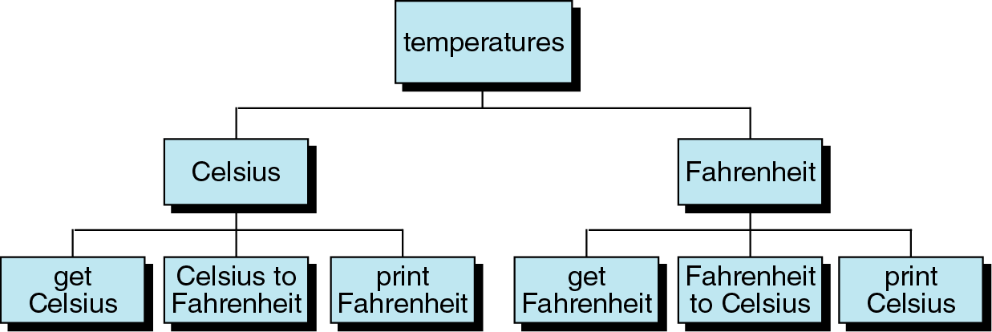
Figure 4-30

